Slide 1
DESIGN AND CORROSION CONTROL
Dr G H Thanki
Director & Principal Consultant
Corrosion Control & Monitoring Consultancy
Vadodara
www.corrosionawreness.com
Lecture delivered as course leader
During Two day Programme on
“Advanced Corrosion Management 2014”
Mumbai on 30th & 31st Jan 2014
Organized by
Indian Knowledge Center

Slide 2
DESIGN AND CORROSION CONTROL
Failure to control corrosion can lead to increased costs,
reduced safety
and
negative environment impact.
Corrosion costs a
significant percentage
(approx 3~4%)
of a nation’s GNP.

Slide 3
DESIGN AND CORROSION CONTROL
It has been estimated that a quarter of all corrosion problems could be prevented easily by using well established techniques.
The economic, social or ecological consequences of major corrosion failures can be ruinous.
Corrosion
INCREASES
running costs
and
REDUCES
plant efficiency, availability and product quality.

Slide 4
DESIGN AND CORROSION CONTROL
Corrosion results from the chemical interaction of a metal with its environment and may be
uniform in nature or localised.
Physical and chemical conditions of the environment influence
both the rate and type of attack,
the nature of corrosion products,
the way in which metallic properties themselves are affected,
and
the corrosion measures needed.

Slide 5
DESIGN AND CORROSION CONTROL
The continued development of material technology and monitoring and control is higher today, and
with favourable applications greater savings are now achievable.
In some types of project, uncontrolled corrosion could amount to
30% of the total commitment of capital expenditure.

Slide 6
DESIGN AND CORROSION CONTROL
Good control of corrosion requires the
AWARENESS
and
CO-OPERATION OF THE ENTIRE DESIGN TEAM
including
engineers and designers
not only in each specialised discipline but in
project management and cost control.
Adequate means for
collecting, reporting and recording corrosion information from
operational situations must also be planned.

Slide 7
DESIGN AND CORROSION CONTROL
The design of most functional components and systems is a multi-disciplinary activity.
Large engineering design contractors integrate the Materials,
Welding,
Painting and corrosion control functions into the design team on a project basis.
This allows decisions on materials and corrosion control to be implemented from the earliest stages of design and construction, and ensures all materials and corrosion control requirements are adequately documented.

Slide 8
DESIGN AND CORROSION CONTROL
Throughout the life-cycle of a metallic fabrication due attention to
DESIGN,
CHOICE OF MATERIALS AND MANUFACTURING
PROCESSES,
TRANSPORTATION,
STORAGE,
START-UP,
OPERATION,
INSPECTION,
MAINTENANCE AND
SHUT-DOWN,
will reduce the cost of corrosion and risk of failure.

Slide 9
DESIGN AND CORROSION CONTROL
Effective and timely consideration of design, corrosion monitoring, corrosion control and the consequences of corrosion failures not reduce the extent and cost of corrosion but enhance the
safety,
functionality,
useful lifetime,
efficient use of resources and
appearance of the fabrication.

Slide 10
DESIGN AND CORROSION CONTROL
Alert List
The following alert list is not for dealing with corrosion after it has happened, but for preventing corrosion at the design stage.
Design consideration factors that can influence corrosion
Environment: chemical, natural, storage, transit
Stress: residual stress from fabrication, static, variable and alternating operating stresses
Shape: joints and flanges, crevices and deposits, trapped and contained liquid
Compatibility: metals with metals, metals with other materials, quality control of materials
Movement: flowing fluids, parts moving in fluids, two and three phase flow, entrained solids, vibration and pulsing
Temperature: oxidation, scales and tarnishes, Heat-transfer effects, molten deposits, condensation and dew points
Control: surface cleaning and preparation, coatings, cathodic protection, inhibitors, data logging, inspection, planned maintenance

Slide 11
DESIGN AND CORROSION CONTROL
ENVIRONMENT
The type of environment to which a material is exposed is a major factor in determining the type and severity of corrosion undergone. Minor constituents of the surroundings can be critical, aggravating or suppressing corrosive attack. Geographical location is also important, as id the influence of weather and season at the time of construction, repair, etc.
Natural Environments
Air
  Rural (farming, fertilisers, ammonia)
  Coastal, marine (chloride)
  Industrial, urban (sulphur dioxide, soot and acid rain)

Slide 12
DESIGN AND CORROSION CONTROL
ENVIRONMENT
Waters
  Rivers, lakes, wells, water pipelines, dams, sea water (tidal, ‘splash zones’), estuaries, harbours (in most of these, chlorides are significant, as well as a variety of corrosive biological agents).
Soils
  Clays, chalk, loam, drainage, acidity, access of air, bacterial action (Sulphate Reducing Bacteria - SRB).

Slide 13
DESIGN AND CORROSION CONTROL
ENVIRONMENT
Chemical Environments
  Urban and industrial atmospheres
  Environmental pollutions creating aggressive mists
  Interior of reaction and storage vessels in chemical plant
Other Environments
  Embedded metals may react with non-metallic materials such as wood, plastics, and concrete. The porosity of some of these media allows contact water.

Slide 14
DESIGN AND CORROSION CONTROL
ENVIRONMENT
Temperature
  Increasing temperature usually causes increased rates of corrosion. A notable exception is when temperature increase reduces relative humidity or dries out the environment completely.
Incident radiation
  Sunlight, ultraviolet light and thermal radiation, can activate short-lived reactive chemical species from contaminants in

Slide 15
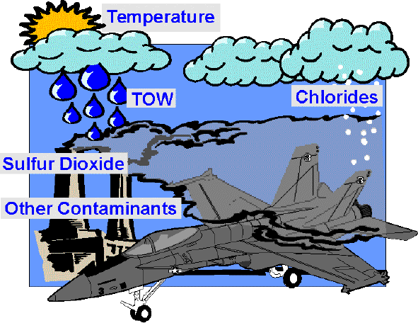
DESIGN AND CORROSION CONTROL
ENVIRONMENT

Slide 16
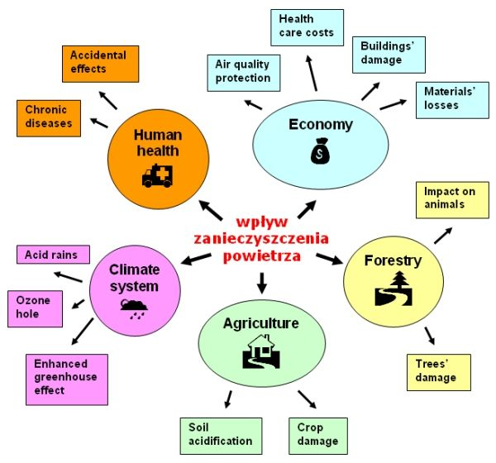
DESIGN AND CORROSION CONTROL
ENVIRONMENT

Slide 17
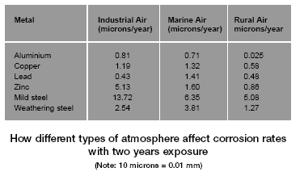
DESIGN AND CORROSION CONTROL
ENVIRONMENT

Slide 18
DESIGN AND CORROSION CONTROL
ENVIRONMENT

Slide 19
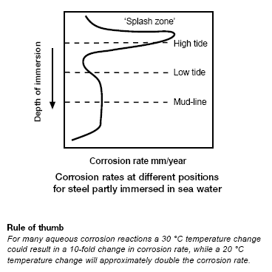
DESIGN AND CORROSION CONTROL
ENVIRONMENT

Slide 20
DESIGN AND CORROSION CONTROL
STRESS
General or uniform corrosion causes progressive loss of cross-section and increased stress levels,
while uneven and localised corrosion causes high stress concentrations.
Design should control
extremes of stress and
environment arising at any time in
the life-cycle of the structure.

Slide 21
DESIGN AND CORROSION CONTROL
STRESS
Think about the following…
Residual and thermal stresses arising from fabrication
Transportation shock and vibration
Installation
Performance and pressure testing, leading to over-stressing , test fluids corrosion
Operating and fault conditions
Maintenance, including effects of modifications and repairs

Slide 22
DESIGN AND CORROSION CONTROL
STRESS
Static stresses
The environment both inside and outside a structure can affect the strengths of the materials specified.
For each alloy,
Stress Corrosion Cracking (SCC)
requires specific environmental corrosive conditions, with the alloy subjected to a critical tensile stress (residual or applied).
SCC is very dangerous because of the progressive nature of the cracking, with ever rising risks of rupture, leakage, or loss of function.

Slide 23
DESIGN AND CORROSION CONTROL
STRESS
Fluctuating stresses and corrosion fatigue
In a corrosive environment the stress level at which it could be assumed a material has infinite life is lowered completely.
Corrosion fatigue and fretting are both in this class.
Much lower failure stresses and much shorter failure times can occur in a corrosive environment
compared to a situation
where the alternating stress is in a
non-corrosive environment.

Slide 24
DESIGN AND CORROSION CONTROL
STRESS
Hydrogen effects and stress
Atomic hydrogen released by cathodic reactions during corrosion can enter metals, causing several significant types of damage.
Hydrogen has a strong tendency to travel are high tensional stress. By several mechanisms, this can cause cracking in steels.
Hydrogen may also be introduced during welding or due to cathodic protection.

Slide 25
DESIGN AND CORROSION CONTROL
STRESS

Slide 26
DESIGN AND CORROSION CONTROL
STRESS

Slide 27
DESIGN AND CORROSION CONTROL
SHAPE
‘Trap’ geometry is poor geometry.
Corrosion may be fostered by retentions of liquids or contact of the metal surface with a local environment differing from that expected by the designer.
Features shown opposite encourage poor drainage, possibilities for solution concentration, differential aeration and poor access for inspection, repair or maintenance.

Slide 28
DESIGN AND CORROSION CONTROL
SHAPE
Think about the effect of the following….
Access
Inspection and maintenance requires adequate access to all parts of structure. Design must allow for easy replacement of material where the risk of corrosion and the consequences of failure are significant.
Joints, flanges
Crevices let stagnant liquid accumulate, causing locally accelerated corrosion from differential aeration.
There can also be contact between dissimilar metals. Slower drying at joints can increase concentration of aggressive salts. Consider the use of appropriate and safe solvents.

Slide 29
DESIGN AND CORROSION CONTROL
SHAPE
Think about the following sources of incompatibility…
Welds
Poor weld profile, lack of fusion and stitch welding can all lead to crevices and stress raisers.
Deposits
Debris on horizontal surfaces can give shielding corrosion (differential aeration corrosion).
Corrosion products and water forming scales can affect heat transfer and cause temperature differential that can lead to corrosion.
Liquid traps
Poorly draining areas can result in increased corrosion generally. Increased corrosion may also occur at the water line zone.

Slide 30
DESIGN AND CORROSION CONTROL
SHAPE

Slide 31
DESIGN AND CORROSION CONTROL
SHAPE

Slide 32
DESIGN AND CORROSION CONTROL
SHAPE

Slide 33
DESIGN AND CORROSION CONTROL
SHAPE

Slide 34
DESIGN AND CORROSION CONTROL
COMPATIBILITY OF MATERIALS
From the point of view of corrosion,
metals may be incompatible with each other or with other materials they contact.
The relative areas of two different metals in electrical contact can affect their
corrosion rates.
This is particularly damaging if the more ‘active’ (anodic) metal has a smaller area.

Slide 35
DESIGN AND CORROSION CONTROL
COMPATIBILITY OF MATERIALS
Think about the following sources of incompatibility…
Within the metal
Fabrication may create differences in metallurgical structure or alloy composition, allowing local attack, such as:
End-grain attack on exposed cross-sections of susceptible wrought metals
Weld decay
Knife-line attack(intergranular corrosion) near welds, especially in some stainless steels
Selective corrosion (or dealloying) of some materials. Dezincification is loss of zinc from brass

Slide 36
DESIGN AND CORROSION CONTROL
COMPATIBILITY OF MATERIALS
Think about the following sources of incompatibility…
Within the environment
A fluid may contain active metallic species that can lead to local corrosion. For instance, dissolved copper in contact with metallic aluminium can cause pitting.
Contact with other materials
Care may be necessary when a metal is in contact with non-metallics, such as plastics, wood, concrete and some electrically conductive mineral species, such as magnetite (magnetic iron oxide) and iron sulphide.
Welds
Changes in weld metal and base metal composition and structure result in galvanic corrosion or intergranular effects, such as weld decay in unstabilised stainless steel.

Slide 37
DESIGN AND CORROSION CONTROL
COMPATIBILITY OF MATERIALS

Slide 38
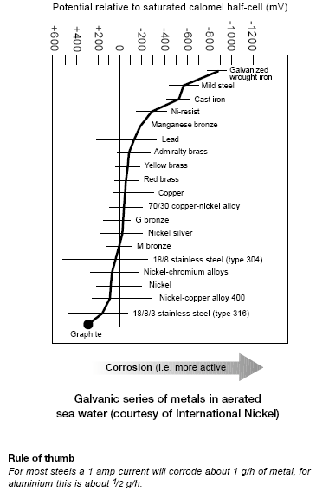
DESIGN AND CORROSION CONTROL
COMPATIBILITY OF MATERIALS

Slide 39
DESIGN AND CORROSION CONTROL
MOVEMENTS
Movements of the corrosive environmental agent and the movement of parts can seriously affect the corrosion rates and mechanisms.
Flowing fluids
The flow of fluids relative to a metal can increase the corrosion rate. Erosion corrosion may become significant at high rates of flow when the flow changes from laminar to turbulent.
Think about the following sources of incompatibility…

Slide 40
DESIGN AND CORROSION CONTROL
MOVEMENTS
Impingement caused when liquids impact on a metal surface.
Damage can rise due to:
Free-falling droplets
Mist droplet impingement in pipe vapour flow at changes of flow direction or internal irregularities
Jetting of droplet-laden vapours
Dripping of liquids onto surfaces
Agitation
Damage due to impingement of solids (erosion).

Slide 41
DESIGN AND CORROSION CONTROL
MOVEMENTS
Cavitation damage can occur in regions associated with steep liquid velocity gradients, where vapour-filled voids may form and collapse supersonically, causing shock waves that damage the metal surface by severe localised attack through massive momentum transfer to the metal.
Areas subject to
Local boiling,
And
Dead-end-locations
can be prone to similar damage.
Parts moving in the fluid
Care is needed when considering metals for moving components such as pump impellers or stirrers, which are susceptible to erosion, impingement and cavitation.

Slide 42
DESIGN AND CORROSION CONTROL
MOVEMENTS
Two-phase and multi-phase fluids
Bubbles, particles and immiscible liquids
(e.g. oil and water)
in moving fluids can increase the corrosion rate.
Differentially wettable solids tend to partition into the most highly wetting liquid phase, increasing its apparent density and tendency to sink.

Slide 43
DESIGN AND CORROSION CONTROL
MOVEMENTS

Slide 44
DESIGN AND CORROSION CONTROL
MOVEMENTS

Slide 45
DESIGN AND CORROSION CONTROL
TEMPERATURE
Higher temperatures
generally increase corrosion rates.
However, corrosion needs a liquid phase and, if drying occurs, higher temperatures may be beneficial.
If operating temperatures are too high a material will oxidise, forming scale.
Thick scales and metal loss result in overheating, from loss of water cooling or absence of insulation.
Heat transfer will be progressively impeded as scales or deposits thicken.

Slide 46
DESIGN AND CORROSION CONTROL
TEMPERATURE
Higher temperatures generally increase corrosion rates.
However, corrosion needs a liquid phase and,
if drying occurs,
higher temperatures may be beneficial.
If operating temperatures are too high a material will oxidise, forming scale.
Thick scales and metal loss result in overheating, from loss of water cooling or absence of insulation.
Heat transfer will be progressively impeded as scales or deposits thicken.

Slide 47
DESIGN AND CORROSION CONTROL
TEMPERATURE
Think about the following …
Environmental factors
Polluted gases can accelerate attack and are often accompanied by heat. Examples are, sulphur trioxide and sulphur trioxide, halogens such as chlorine compounds, nitrogen oxides, carbon particles such as soot and hydrolysable organic compounds.
Source of heat
Heat sources include:
Electrical heating elements
Steam heating

Slide 48
DESIGN AND CORROSION CONTROL
TEMPERATURE
Think about the following …
Environmental factors
Heat from ongoing process chemistry
Fuel combustion – flue gases and deposits
Flame impingement
Molten metals
Friction and wear
Solar radiation and radiation from gas flares
Processes such as drying
Engines and motors

Slide 49
DESIGN AND CORROSION CONTROL
TEMPERATURE
Remember,
some sources of heat can be very localised such as electrical contacts or heaters of any type.
In many cases thermal cycling occurs, this can accelerate the corrosion rate and introduce combined effects.
Small temperature changes can produce marked changes in corrosion resistance.
Condensation – dew point effects
When hot combustion gases cool, condensation may give rise to acid dew point conditions.
This can occur with chimneys, vehicle exhausts, power and process plant and certain horticultural environments.

Slide 50
DESIGN AND CORROSION CONTROL
TEMPERATURE

Slide 51
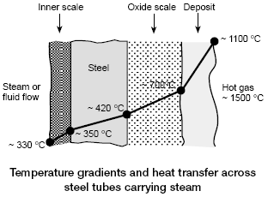
DESIGN AND CORROSION CONTROL
TEMPERATURE

Slide 52
DESIGN AND CORROSION CONTROL
TEMPERATURE

Slide 53
DESIGN AND CORROSION CONTROL
USE OF PAINTS AND COATINGS
Painting or coatings is the mainstay of corrosion prevention for
materials not inherently corrosion resistant.
This is a matter of economics.
Paints and coatings are generally applied at low additional cost to the least expensive structural materials.
Minimising the additional cost is an integral part of ensuring the economic viability of painting and coating as a
corrosion control solution.
Therefore paints and coatings generally do not last as long as the operating lifetime of the material to be protected,
the ability to maintain the coating systems is vital.

Slide 54
DESIGN AND CORROSION CONTROL
USE OF PAINTS AND COATINGS
Factors in selection of paint or coating systems
When choosing a system, several alternatives may appear to be technically acceptable, and it is necessary to identify relevant factors affecting corrosion control and cost.
The most important of these are:
High project cost, prestige or failure consequences may warrant choice of high performance materials
Type of substrate to be coated
Track record of the selected system for the environmental and operating conditions expected
Life expectancy of coating to first maintenance

Slide 55
DESIGN AND CORROSION CONTROL
USE OF PAINTS AND COATINGS
Factors in selection of paint or coating systems
Ease of access to substrate work surface
Quality of applicator and contractor
Compliance with legislative and environmental requirements
Delivery logistics
Maintenance conditions, and compatibility with existing materials

Slide 56
DESIGN AND CORROSION CONTROL PAINTS AND COATINGS - Costing
Costing of a single system
The costing of a single system must be a compromise between various individual cost factors, typically including:
Materials
Labour
Transport
Cost comparisons of different coating systems
These are more complex, and such aspects as painting conditions, substrate preparations, humidity, temperature and time available must be considered.
Estimation of painting costs
Painting costs are estimated either as total cost or cost per square metre. Several objectives and subjective factors are important for estimating valid painting costs.

Slide 57
DESIGN AND CORROSION CONTROL
PAINTS AND COATINGS - Costing
Overspray of Fabrication
Even on uncomplicated substrates this can amount to 5% despite efficient airless spraying.
Wind Loss
Paint application in the open in high wind can cause losses of 20% to 50%
General Losses
Factors such as exceeding pot life, pilferage and spillage need consideration in estimating paint consumption.
Absorbent Surfaces
A factor of 2% to 5% should be considered for inadequately sealed wood surfaces, as they tend to absorb paint into the substrate.

Slide 58
DESIGN AND CORROSION CONTROL
PAINTS AND COATINGS - Costing
General
Even with well trained operatives,
‘on the job’ inspection
and
good QA/QC procedures,
the paint estimator should add a
baseline factor of 25%
to the paint consumption calculation.
All other ‘listed factors’ will then need to be considered.

Slide 59
DESIGN AND CORROSION CONTROL
PAINTS AND COATINGS - Costing
Coverage rates and paint types
Solventless and solvent-free coatings are invariably much more expensive than normal solvent-bound types
but,
for a given DFT,
they yield a much higher coverage rate than solvent-bound types.
The example opposite illustrates this for the three coating types at a coverage of 200 micron DFT.
In this case, the use of solvent-free materials,
though more expensive in cost per litre,
actually works out cheaper.

Slide 60
DESIGN AND CORROSION CONTROL
PAINTS AND COATINGS - Costing

Slide 61
DESIGN AND CORROSION CONTROL
PAINTS AND COATINGS - Costing

Slide 62
DESIGN AND CORROSION CONTROL
PAINTS AND COATINGS - Costing

Slide 63
DESIGN AND CORROSION CONTROL
Various corrosion control measures are available, one or more of which might be appropriate.
The full life-cycle must be considered as corrosion may occur at any stage.
Materials selection, fabrication, shape and cost are all significant.
Corrosion control measures must be able to reduce risk to a
Quantifiable and Appropriate Low Level
where the consequences of failure are serious.

Slide 64
DESIGN AND CORROSION CONTROL
Corrosion allowance
Metal added to the design thickness against general corrosion loss is generally
0.5 mm to 6.0 mm
for many engineering purposes.
Where the progress of depleting the corrosion allowance must be recorded,
‘day one’ corrosion thickness should be measured at appropriate locations as a measurement bas-line.
Mill tolerance of plate, pipe and other shapes are not precise enough as a basis for loss-of-thickness estimation.

Slide 65
DESIGN AND CORROSION CONTROL
Effect of surface condition
Corrosion rate is aggravated by
SURFACE CONTAMINANTS
such as mill scale, surface rust, dust, oil, grease and by
DEFECTS,
such as scratches, machine marks, pits, dents, ridges from local stresses, porosity and casting defects.
Effects of Surface cleaning
Different surface preparations and cleaning procedures are required for different operating conditions and for different types of coating.
The range of cleaning procedures includes mechanical, chemical, steam and flame methods.

Slide 66
DESIGN AND CORROSION CONTROL
Coatings
The choice of coating is related to its
intended function.
This can include coating for visual decorative appearance, temporary coating for transport or storage, using wax, grease or other water repellent, and long-term corrosion protection, using organic, inorganic or metallic coating systems.
Access for inspection and maintenance
is always essential
because of the risk of gaps (‘holidays’) in the original coating, and because the lifetime of coatings is usually shorter than the plant or equipment design lifetime.

Slide 67
DESIGN AND CORROSION CONTROL
Inhibitors
These are substances added in small concentrations to reduce the corrosion rate.
Liquid-phase or vapour-phase varieties are used in closed systems such as central heating, power boilers, sealed packaging.
In chemical process systems having a throughput of process fluids, such batch or continuous inhibitor addition is practiced.
Maintenance
Planned maintenance is desirable.
Records of installation, maintenance and repair dates are needed. Corrosion inspection and testing can be useful.

Slide 68
DESIGN AND CORROSION CONTROL
Corrosion control and system history
Repairs or local changes in a system may alter the requirements for corrosion inhibitors or chemicals required for process control.
Time-related corrosion changes in a system must also be accounted for;
THE INTERNAL SURFACE OF A PIPE INCREASES AS IT IS ROUGHENED BY CORROSION.
This can increase the amount of surface active chemicals needed to control corrosion.

Slide 69
DESIGN AND CORROSION CONTROL
Quality control
Confusion of materials must be avoided, especially if repairs are to be carried out in a planned maintenance programme.
Materials for some specially corrosive applications require full traceability from manufacture through to installation
Where resistance to corrosion depends on correctly applied welding technology, it should be carried out to appropriately designed and qualified welding procedures.

Slide 70
DESIGN AND CORROSION CONTROL
Do’s
Minimise stress raisers, sharp profiles, threaded screw roots and other stress concentration effects
Protect materials in environments conductive to stress corrosion cracking
Prevent local concentration of contaminants such as in crevices, absorbent thermal insulation, hollows or droplet evaporation points
Always consult relevant codes of practice
Select a resistant material
Consider the use of inhibitors
If necessary use a protective coating

Slide 71
DESIGN AND CORROSION CONTROL
Do’s
Protect materials in transit
Design for streamline flow
Increase thickness of material where necessary
Minimise stress levels and design to even out variations
Filter out abrasives and contaminan
Consider the effect of combined action such as stress regime, flow, thermal variations
Avoid galvanic couples
Contact experts for specific advice

Slide 72
DESIGN AND CORROSION CONTROL
Do’s
Remember, corrosion is a surface phenomenon and consider the performance of the specified surface in service not just the bulk materials properties
Remember, it is not always possible to prevent corrosion occurring but it is always possible to take measures to control it sufficiently
A well designed system should incorporate features that facilitate maintenance and inspection
The control of corrosion is a team activity. Consult manufacturers, users and other service providers to ensure that the control measures can be carried out as expected.

Slide 73
DESIGN AND CORROSION CONTROL
Dont’s
Substitute a material with a proven track record on the basis of cost saving, without considering possible loss of corrosion control
Use data without checking that the environment and conditions in use relate to those under which the data was collected
Ignore good practice guidelines
Ignore the possibility that small changes in the environment or operating conditions could have a dramatic affect on corrosion control
Forget to allow for excursions outside of the bounds of normal operating conditions
Assume maintenance procedures that seem easy to carry out on paper can be carried out as easily in practice

Slide 74
DESIGN AND CORROSION CONTROL
Dont’s
Leave corrosion control until the last step in the design process and rely on remedial control measures
Ignore the environmental impact associated with control measures, coatings or maintenance procedures
Extend the times for cleaning processes or surface treatments beyond manufacturers recommendations as this can create problems
Ignore the possibility that combined action such as stress and corrosion could significantly reduce life times
Use rate data for uniform corrosion to estimate life times for localised corrosion
Use calculation of corrosion rates as a basis for design, when a better design could eliminate the corrosion problem

